Slide 1
QM&CQAF
The expansion of the EU-approaches
to providing the partner-countries
higher education quality assurance
Ivanovo State University

Slide 2
IvSU today
2
since 1918;
a lifelong learning educational center;
active research in natural and social sciences;
a member of Eurasian association of universities and Russian Association of Classical Universities;
strong collaboration with universities of Berlin, Passau, Uppsala, Aarhus, Herning and Xiangtan;
a local gateway for international students.

Slide 3
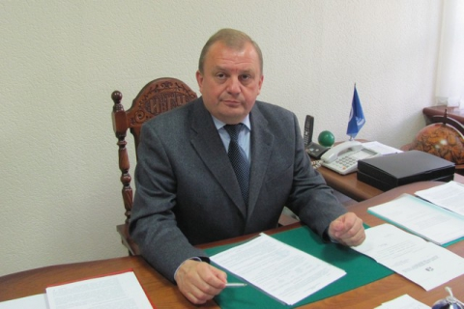
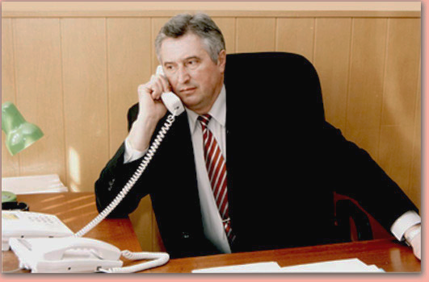
Project Leadership
3
Vladimir EGOROV,
dr.sc., professor,
rector of IvSU
Vladimir NAZAROV,
dr.sc., professor,
first vice-rector of IvSU

Slide 4
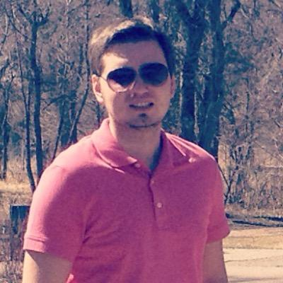
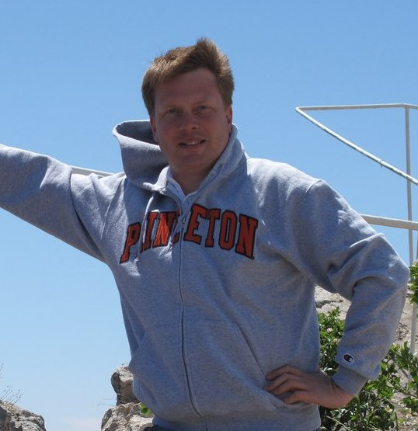
Project Team
4
Nikita SOROKIN,
Ph.D, Project Manager
Alexey MALYGIN,
Ph.D, Head of the
Department
for Educational Programs

Slide 5
Roles and Duties
5
performing interviews and national reports;
QM&CQAF adapted conception development;
model trainings and tutorials;
national level discussions organization;
pursue research of locals embracing adapted QM&CQAF model

